Slide 1


Marriage: Fighting for God’s Best
Jerry Lankford MBA, MACC, Mdiv, LPC
^{lifecarecc.com}

Slide 2
Marriage as Covenant
Covenant is a treaty between a great king (suzerain) and a lesser king (vassal).
  We have approximately 90 of these documents on tablets from the dating back to 2000 BC and the time of Abraham.
Genesis 15:9-21
  Animals Scarified – Cut in Half
  Kings passed between them–“may it be so to me”.
  Oath Sworn

Slide 3
Marriage as Covenant
Malachi 2:14 –
  The LORD is acting as the witness between you and the wife of your youth, because you have broken faith with her, though she is your partner, the wife of your marriage covenant.
Genesis 2:18-25
  Purpose – to work the garden and guard it.
  Helper
  Deep Sleep – Just like Abram
  Adam was cut rather than the animals
  Adam named her woman
  They were naked and unashamed

Slide 4
Intimacy
Naked
Unashamed
Physically
Emotionally
Spiritually
Intellectually
Known
Unknown
Public
Known
Public
Blind
Unknown
Hidden
God

Slide 5
Result of the Fall
Hid from each other – Fig leaves
Hid from God
Blamed each other
Banished from the presence of God
Condemned to Toil
Condemned to Desire man and to pain in child birth
Promise of Redemption

Slide 6
Marriage as Metaphor
Marriage is a picture of the relationship God desires with us.
  Scripture begins and ends with a marriage.
  Marriage Supper of the Lamb
  Bride of Christ
  Christ as the Bridegroom
  The parable of the ten virgins
  Hosea – marriage to a prostitute Gomer
  Song of Solomon

Slide 7
Marriage as Metaphor
Why did God create marriage?
  As a picture of the relationship he desires to have with us his church.
  It is the most intimate relationship we experience on earth.
Covenant Focus
  Permanent Commitment before God
  Stipulations and Oaths
    Love and Honor
    Better or Worse, Richer or Poorer, Sickness and in Health
    Till Death do us part
  Names

Slide 8
Marriage and Intimacy
Intimacy –
  Multi Dimensional – Physical, Emotional, Spiritual, Intellectual
  Requires Knowing and Being Known
  Willingness to be Vulnerable and Exposed (Naked)
  Willingness to receive and give
  Willingness to surrender control
  Commitment to placing the other person before self.

Slide 9

Five Stages of Marriage
(Feels good)
(Enchantment, delight)
Passion Starts High
May last days, weeks, or years
(Selfish, I, me, my)
(Tensions Emerging
Differences, Selfishness)
Most Marriages Fail in this Stage
(Transition)
(Transition to acceptance, taking personal responsibility in relationship)
Move from “resisting” to “receiving” one another”
(Selfless- We, Us, Our)
(Togetherness, secure sense of belonging)
Agape love takes control
Christ lives through both mates
(outward focus)
(Maturity, pronounced intimacy, joint efforts)
Joint Ministry of Love
Balanced Inward and outward focus
Dream
Stage
Reality
Stage
Obedience
Stage
Harmony
Stage
Reflection
Stage

Slide 10
Communication
The Art of knowing and being known
Rule Number One – Safety, Safety, Safety
  How can we be vulnerable and exposed if it is not safe.
Key to communication is listening
Arguments Escalate in Volume.
  Each person wants to be heard/understood
  When a person doesn’t feel heard they repeat themselves and speak louder.

Slide 11
Speaking in Code
Sometimes we speak in code because it is safer or we are hoping the person will pick up on our subtle message.
  “There is a new restaurant in town” means I wish you would take me there.
  “I’m really tired tonight.” means Would you take us out to dinner.
We (men) are lousy mind readers.
  We need to make the implicit explicit.
  Say what you mean and own what you say.

Slide 12
Using I statements
No one wants to be told what they think, they want to be asked.
You statements are loaded with “projection” that causes resentment.
  “You don’t value what I do?”
  Vs. ”I don’t feel appreciated for what I do.”
I statements take ownership for what we are feeling without projecting blame.
Form: “When you do this behavior, I feel …”

Slide 13
More Recommendations
Be Fair – Non-Judgmental
  Don’t use Words like Always and Never
  Stick to the issue, don’t gunny sack.
Use timeout and safe words
  Timeout when things get heated
    Limited time and called by either party
Don’t leave and don’t shut down, stay engaged.
  Causes emotional response of abandonment and rejection. Unfair.

Slide 14
Active Listening
Rules for the Speaker
  Speak for yourself, Don’t mind read
  Keep statements brief. Don’t go on and on.
  Stop to let the listener paraphrase
Rules for the Listener
  Paraphrase what you hear.
  Focus on the speaker’s message. Don’t rebut.
Rules for both
  The speaker has the floor.
  Speaker keeps the floor while the listener paraphrases
  Share the floor

Slide 15
Listening like Jesus
How did Jesus handle communication?
He knew who he was.
  What a person says is about them, not about you.
  Even when they say it is. It is really about how they are feeling.
He listened for what was going on with that person.
  He responded with compassion or rebuke
  His responses were always aimed at answering the real issue.

Slide 16
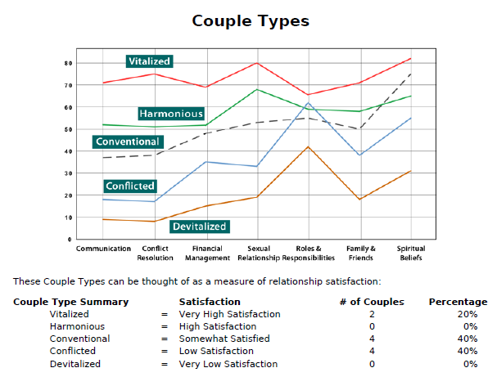

Slide 17
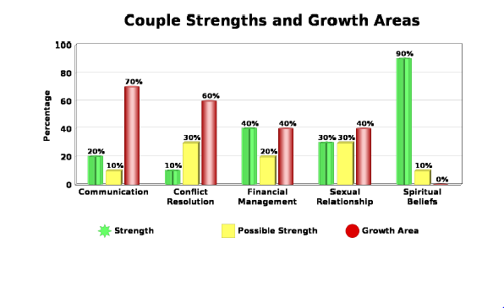

Slide 18
Top 10 Intimacy Needs
Myself | Intimacy Need | Partner
□ | Acceptance-deliberate and ready reception with a favorable positive response (Rom 15:7) | □
□ | Affection – to communicate care and closeness through physical touch (Rom 16:16) | □
□ | Appreciation – to communicate with words and feelings a personal gratefulness for another (1 Cor. 11:2) | □
□ | Approval – expressed commendation; to think and speak well of (Rom. 14:18) | □
□ | Attention – to take thought of another and convey appropriate interest and support; to enter into another’s world (1 Cor. 12:25) | □

Slide 19
Top 10 Intimacy Needs
Myself | Intimacy Need | Partner
□ | Comfort (empathy) – to come alongside with word, feeling and touch; to give consolation with tenderness (Rom 12:15) | □
□ | Encouragement – to urge forward and positively persuade toward a goal (1 Thes. 5:11, Heb. 10:24) | □
□ | Respect – to value and regard highly; to convey great worth (Rom. 12:10) | □
□ | Security – confidence of harmony in relationships; free from harm (Rom. 12:16a) | □
□ | Support – come alongside and gently help carry a load (Gal 6:2) | □

Slide 20
Love Languages
How did your family express love growing up?
Myself | Love Language | Partner
□ | Quality Time | □
□ | Physical Touch | □
□ | Gifts | □
□ | Acts of Service | □
□ | Word of Affirmation | □

Slide 21
Love Languages
When we show our love to our partner in a way that is not their love language they may miss the message and not feel loved.
Wife – “you never show me that you love me.”
meaning, you never buy me flowers.
Husband – “what do you mean, I go to work every day and provide a living for you?”,
Husband – “yesterday, I tried to kiss you and you turned away, I don’t feel loved.”

Slide 22
Love Languages
We need to know what makes the other person feel loved and show them in that way.

Slide 23
Marriage Staff Meetings
Schedule a time - Weekly
  Lunch Time
  Evening
Prioritize the time
  Consistency
Protect the time
  From interruptions
  Away

Slide 24
Marriage Staff Meetings
Typical Agenda
  Calendar Coordination
  Discuss Family Goals
  Parenting Plans
  Listening Times
  Productive “Criticism”
  Appreciation

Slide 25
Zone Chart
 | Sun | Mon | Tues | Wed | Thru | Friday | Sat
Morning | Worship
Afternoon |  |  |  |  |  |  | Family
Evening |  |  | His |  | Hers | Date

Slide 26
Relationships
Interdependence
Independence
Dependence

Slide 27
Our Identity
Who we are is defined by Christ not by other people.
  Most depression and anxiety is caused by a break down in this one simple truth.
We must know who we are and be able to stand in that truth in order to have healthy relationships.
Galatians 2:20 ²⁰ I have been crucified with Christ and I no longer live, but Christ lives in me. The life I live in the body, I live by faith in the Son of God, who loved me and gave himself for me.

Slide 28
Wounds
Deeply held beliefs about yourself or the world as the result of hurt or neglect.
They are based in our interpretation at the time about what occurred.
These beliefs cause us to see the world through a filter that interprets similar events in the same way.
They amount to agreements with the enemy that he uses to enslave us.
Almost everyone has some wound.

Slide 29
Examples of Wounds
Simple – a 2 year old is bitten by a dog. All dogs are dangerous.
A father’s comment – you are lazy, fat, or some other negative comment.
Friends taunting – you are a cry baby, or not chosing you for a ball game. Dropping a key ball
Mother – you will never amount to anything.
Lose of a Parent or Grandparent
Sexual or Physical Abuse

Slide 30
Loving our Wives
Ephesians 5:23-26 ²³ For the husband is the head of the wife as Christ is the head of the church, his body, of which he is the Savior. ²⁴ Now as the church submits to Christ, so also wives should submit to their husbands in everything. ²⁵ Husbands, love your wives, just as Christ loved the church and gave himself up for her ²⁶ to make her holy, cleansing her by the washing with water through the word,

Slide 31
Leadership
Walk the Talk
Create a Shared Vision
Challenge the Process
Empowering Others to Act
Encouraging the Heart

Slide 32
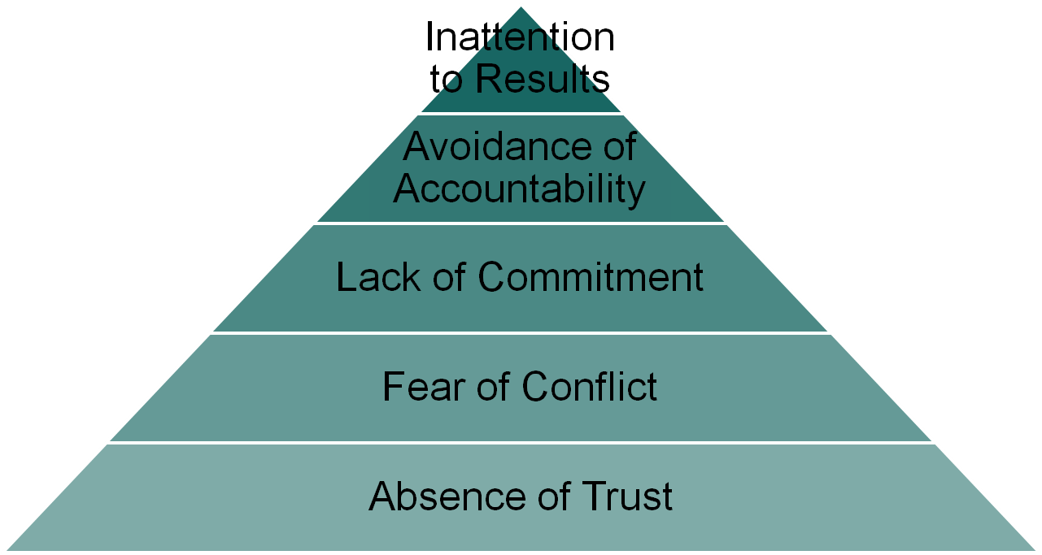
Five Dysfunctions of a Team

Slide 33
What are sources of conflict?
Communication
Roles and Responsibilities
Finances
Sex
Extended Families
Parenting
How to spend leisure time
Others?

Slide 34
Communication
Feeling listened to
Feeling understood
The ability to ask for what you want
The ability to share negative feelings
Whether or not you refuse to discuss problems
Your satisfaction with how you talk to each other
Your willingness to share feelings

Slide 35
Conflict Resolution
Bringing differences to a point of resolution
Feeling understood while discussing problems
The ability to express feelings/ideas while resolving
differences
Whether or not you end up feeling responsible for
problems
Whether or not you have disputes over trivial issues
Whether or not you say nothing to avoid hurting one
another
Your approach to solving disagreements

Slide 36
Ten Steps for Resolving Conflict
Set a time and place
Define the problem – be specific
List the ways you each contribute to the problem
List past attempts to resolve the issue that were not successful
Brainstorm – Pool your new ideas and try to list 10 possible solutions to the problem. Do not judge or criticize any of the suggestions.

Slide 37
Ten Steps for Resolving Conflict
Discuss and evaluate each of these possible solutions
Agree on one solution to try
Agree how you will each work toward this solution: Be specific
Set up another meeting to discuss your progress
Reward each other for progress.

Slide 38
Financial Management
How credit and charge accounts are used
How money is handled
Making financial decisions together
Sharing financial control
Spending priorities
Your level of debt/unpaid bills

Slide 39
Finances
What to do with limited resources
  Crown Financial, Dave Ramsey
Managing Finances
  Who pays the bills?
  Is there one checking account or two?
  Is there a budget? How do we control spending
  Agreeing on a maximum without approval
  Discretionary Money
Goals – Retirement, College, Savings

Slide 40
Parenting
How much time is spent with the children
How parenting responsibilities are shared
How you discipline your children
How children have impacted your relationship/closeness
How much you provide financially for your children
Whether or not children create problems in your relationship
Your children's religious upbringing

Slide 41
Parenting
Remember – the marriage comes first.
  Kids will not feel secure if the marriage is not solid.
  Parents have a tendency to triangulate with kids when the marriage is not solid.
You must be aligned in your parenting and discipline.
Remember – your kids learn who God is from their relationship to you. You are:
  Omniscent, Omnipotent, OmniPresent, and the Provider of all things..

Slide 42
Parenting
Young Kids –
  Couch Time– 15 minutes a day in a visible area. The parents focus on one another and interruptions are not allowed
Rules
  Reward good behavior quickly and often
  Don’t “accidentally” reward bad behavior.
  Correct some bad behavior but do it mildly
Don’t count to three

Slide 43
Parenting - Adolescents
Demonstrate the respect you expect
  Request and Negotiate
    I need you to do this, when can you do it by?
  Focus on Integrity
Set Expectations and Boundaries. Define consequences
Don’t punish when angry – we want kids to think.
  Ask them to write an essay explaining why what they did is bad and recommending the consequences.
Don’t have to have the last word – let them

Slide 44
Sexual Relationship
Whether or not affection is used or refused
Fostering an interesting and enjoyable sexual
relationship
Having similar levels of interest in sex
Sexual interest and attraction
The amount of affection expressed
Your openness in discussing sexual topics
Your satisfaction/fulfillment with sexual relationship

Slide 45
Sexual Relationship
Frequency
Scheduling
  Spontaneous or Planned
Romance and Fantasy
Intimacy and Love
  Why did God create sex?
  What does the Bible say about it?
1 Corinthians 6
We can’t make love if we are angry

Slide 46
Forgiveness
Matthew 6:12,14-15 ¹² Forgive us our debts, as we also have forgiven our debtors. ¹⁴ For if you forgive men when they sin against you, your heavenly Father will also forgive you. ¹⁵ But if you do not forgive men their sins, your Father will not forgive your sins.
Forgiveness is not optional
  Christ forgave us before we knew we needed it.
Forgiveness sets us free from the bondage of anger. Matt 7:1-2
Forgiveness is a supernatural act. It requires the help of the Holy Spirit

Slide 47
Reconciliation
Forgiveness is not the same as Reconciliation 2 Cor 5:18-19
  This requires both parties
Forgiving a Debt does not mean extending more credit.
Reconciliation involves the offending party recognizing their need for forgiveness and repenting. 1 John 1:9

Slide 48
Tests of Forgiveness
I no longer dwell on the offense. This does not mean that I have forgotten it, but I no longer ruminate on it.
I do not talk with others about it.
I do not use it against the person.
I do not allow it to get in the way of my relationship with that person.

Slide 49
Forgiveness
Matt 18 – The Unmerciful Servant
  Talent – Bar of Silver worth 20 years salary
  10,000 – Largest number in Roman System
  Denarii – Day’s wage
  100 Denarii worth a 1/3 of a years income. Non-trivial.
Sets us free
Protects us from Judgment – Matt 7:1-2
Allows us to worship

Slide 50
Praying Forgiveness
Where two or more are gathered – there is power in having a witness
List all the ways you have been offended and present them to God for his justice.
  Give them to him don’t ask him to take them.
Confess all the ways you have given offense
  Including being unforgiving.
Ask God to Bless them – Romans 12:14
Ask God to Bless you.

Slide 51
Apologies
Address everyone involved
Avoid: If, but, maybe
Admit Specifically
Acknowledge the hurt
Accept the consequences
Adjust your behavior
Ask for forgiveness

Slide 52
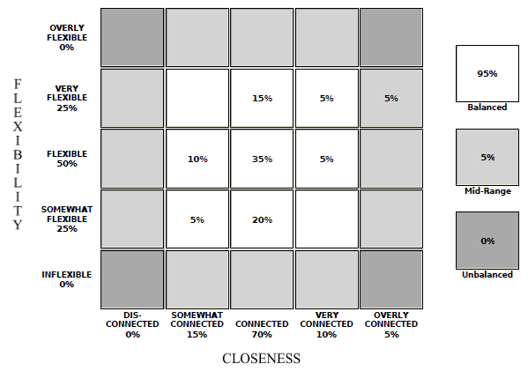
Couple Closeness

Slide 53
Families
Flexibility – ability to adapt and change
Closeness – distance vs overly connected
Boundaries
  Structured - normal
  Formal – lack a sense of attachment
  Enmeshed – lack a sense of distinctive self

Slide 54
Boundaries
Great Book – “Boundaries” by Henry Cloud
Setting limits to our relationships that protect ourselves and keep things healthy.
Examples –
  Call before you come over.
  Don’t call after 10:00 or before 8:00
  Let’s only get together once a week
  I expect you home by 10:00

Slide 55
Our Identity
Who we are is defined by Christ not by other people.
  Most depression and anxiety is caused by a break down in this one simple truth.
We must know who we are and be able to stand in that truth in order to have healthy relationships.
Galatians 2:20 ²⁰ I have been crucified with Christ and I no longer live, but Christ lives in me. The life I live in the body, I live by faith in the Son of God, who loved me and gave himself for me.

Slide 56
Standing for our Spouse
Once we know who we are then we can stand up for our spouse.
Our spouse is not the enemy, they are part of our team. It is the enemy that is our attacking us.
We need to have our spouses back.
  Nothing hurts more than to feel betrayed by our spouse at the very point we need them to defend us.

Slide 57
Fighting for God’s Best
Marriage is God’s Best
  It is a picture of the relationship he desires for us.
Satan hates marriage and wants to destroy it.
  We have to learn how to fight for our marriage
  Our spouse is not the enemy, he is.
  When we communicate well, we strengthen each other and build up our marriage and address the issues we face.

Slide 58
Bereavement and Grief
Denial
Bargaining
Anger, Depression
Acceptance
Great Sense of Loneliness and sense of Absence.

Slide 59
Bereavement and Grief
What to do?
Immediately
  Be There
  Assess their Resources – Friends, Family
  Encourage them to talk about the person
  Help with planning, calling, organizing.
Why? Be willing to say I don’t know
Pat Answers and Clichés are not helpful. Instead
  I know, I see how much you are hurting, I’m miss them too.

Slide 60
Bereavement and Grief
What to do?
Later
  Be There especially after everyone leaves
  Encourage them to talk about the person
  Every First Anniversary
    Reach out and connect
    Birthday, Anniversary, Christmas, Easter, Thanksgiving

Slide 61
When to Refer?
Whenever it doesn’t seem normal or beyond you ability to help.
  You know when something doesn’t seem to fit or doesn’t feel quite right.
Whenever it requires more time and resources than you have.
  Pastors should spend a maximum of 3-5 sessions.

